Slide 1
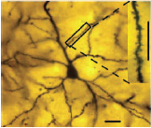
Perceptron
JST 2 - Perceptron

Slide 2
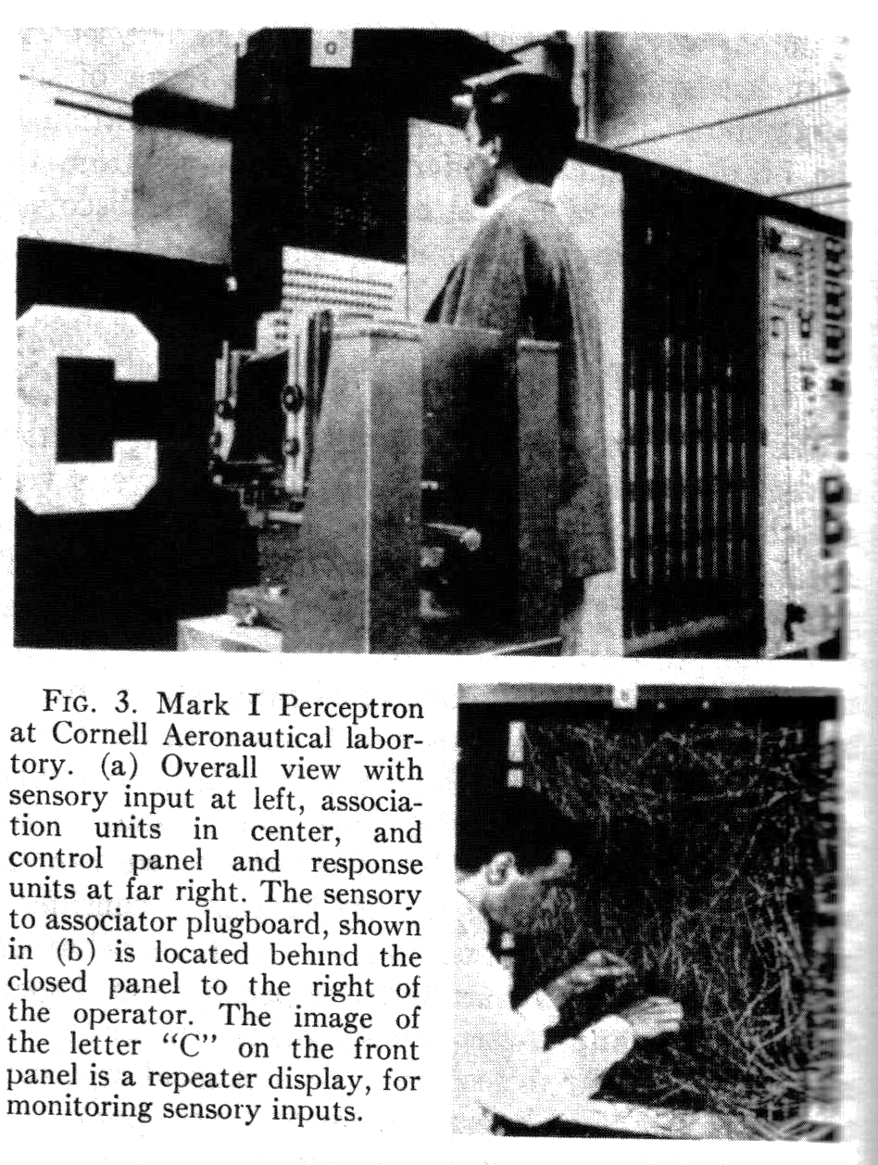
Perceptron - history
Proposed by Rosenblatt et al. (1958-1962).
A large class of neural models that incorporate learning.
“Mark I” perceptron is built with a retina of 20 X 20 receptors.
Learned to recognize letters.
Created excitement, and hype. (ENIAC was built in 1945)
JST 2 - Perceptron

Slide 3
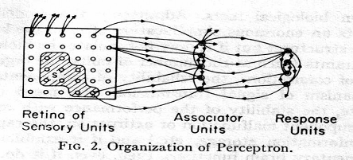
Perceptron - structure
A perceptron is a network of S, A and R units with a variable interaction which depends on the sequence of the past activity states of the network (Rosenblatt; 1962).
S: Sensory unit
A: Association unit
V: Variable interaction matrix
R: The learning unit, a.k.a. the perceptron
Learning: Setting the weights of V such that the network correctly classify the input patterns.
JST 2 - Perceptron

Slide 4
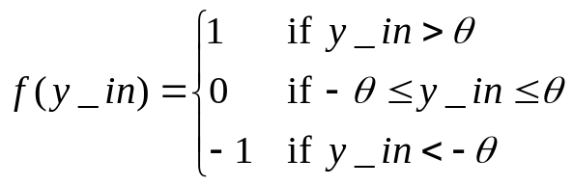

Perceptron – clearer structure
Associative
units
Retina
Response unit
Variable weights
Fixed weights
0
Step activation function
JST 2 - Perceptron

Slide 5



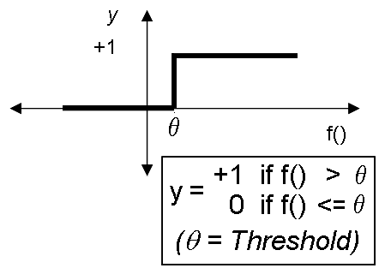



Perceptron - neuron
Perceptron's activation y depends on the (linear) sum of inputs (including a bias) converging on the neuron through weighted pathways.
x₁, x₂,…,x_{N} can be continuous.
It can Learn!
JST 2 - Perceptron

Slide 6





Input space representation
x₂
(0,1,0)
(1,1,0)
1
(0,1,1)
(1,1,1)
(0,1)
(1,1)
(0,0,0)
(1,0,0)
(0,0)
(1,0)
x₁
(0,0,1)
(1,0,1)
0
1
2-dimensional
input space
3-dimensional
input space
JST 2 - Perceptron

Slide 7






Classification problem
Imagine that there are two groups patterns:
  One group is classified as A
  The other classified as B
The Problem:
How can one (computer) learn to correctly classify the input patterns:
  Those that were seen before
  Those that were not seen before.
Not an easy problem!!
A/B ??
JST 2 - Perceptron

Slide 8
Boolean AND
input x1 | input x2 | ouput
0 | 0 | 0
0 | 1 | 0
1 | 0 | 0
1 | 1 | 1
w₀= −1.5
X₀ = 1
w₁=1
w₂=1
x₁
x₂
X0 | X1 | X2 | S | y
1 | 0 | 0 | - 1.5 | 0
1 | 0 | 1 | - 0.5 | 0
1 | 1 | 0 | - 0.5 | 0
1 | 1 | 1 | + 0.5 | 1
JST 2 - Perceptron

Slide 9
Boolean OR
input x1 | input x2 | ouput
0 | 0 | 0
0 | 1 | 1
1 | 0 | 1
1 | 1 | 1
w₀= −0.5
X₀ = 1
w₁=1
w₂=1
x₁
x₂
X0 | X1 | X2 | S | y
1 | 0 | 0 | - 0.5 | 0
1 | 0 | 1 | + 0.5 | 1
1 | 1 | 0 | + 0.5 | 1
1 | 1 | 1 | + 1.5 | 1
JST 2 - Perceptron

Slide 10
Inverter (Boolean NOT)
input x1 | output
0 | 1
1 | 0
w₀= 0.5
X₀ = 1
w₁= −1
x₁
X0 | X1 | S | y
1 | 0 | + 0.5 | 1
1 | 1 | - 0.5 | 0
JST 2 - Perceptron

Slide 11
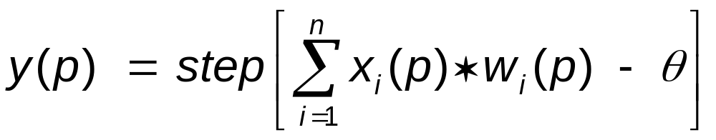
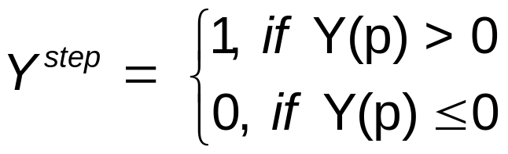
Perceptron Learning (Negnevitsky, 2005)
Step 1: Initialisation
Set initial weights W₁, W₂, . . . ,W_{n} and threshold θ to random numbers in the range (-0.5, 0.5).
Step 2: Activation
Activate the perceptron by applying inputs X₁(p), X₂(p), . . . , X_{n}(p) and desired output Y_{d}(p). Calculate the actual output at iteration p = 1
where n is the number of the perceptron inputs, and step is a step activation function.
JST 2 - Perceptron

Slide 12
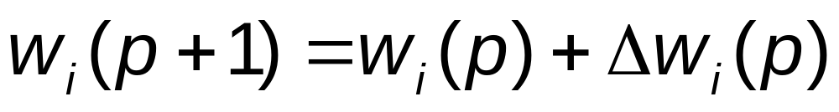
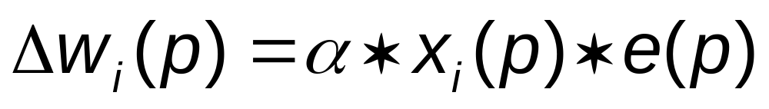
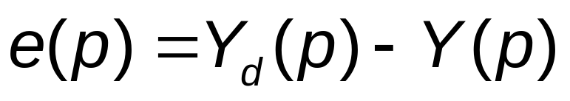
Perceptron Learning (Negnevitsky, 2005)
Step 3: Weight training
Update the weights of the perceptron
where Δw_{i}(p) is the weight correction at iteration p.
The weight correction is computed by the delta rule:
where α is the learning rate (a positive constant less than unity) and e(p) is error at iteration p.
where Y(p) is the actual output and Yd(p) is the desired output
Step 4: Iteration
Increase iteration p by one, go back to Step 2 and repeat the process until convergence (error is sufficiently low).
JST 2 - Perceptron

Slide 13
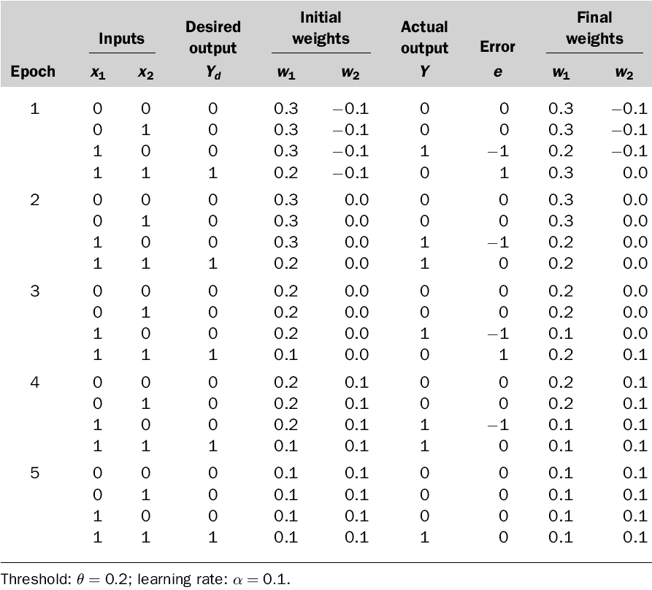
Example: AND Gate
JST 2 - Perceptron

Slide 14
Perceptron learning (C++)
#include <stdio.h>
#include <conio.h>
#include <stdlib.h>
#include <time.h>
int x[4][3] = {{1, 0, 0}, {1, 0, 1}, {1, 1, 0}, {1, 1, 1} }; //input
float w[3], corr; //weights array & learning coefficient alpha
int r[4]; //correct response array
int resp, diff, i, wrongresp=1, c;
void main(){
system("CLS");
//input the correct response array
for (i = 0; i < 4; i++){printf("Input correct response r[%i] = ", i); scanf("%d", &r[i]);}
//assign the weights randomly
srand(time(NULL));
w[0]=(rand() % 1000)/1000.0;
w[1]=(rand() % 1000)/1000.0;
w[2]=(rand() % 1000)/1000.0;
printf("\nThe initial weights are %f %f %f\n", w[0], w[1], w[2]);
JST 2 - Perceptron

Slide 15
Perceptron learning (C++)
//input the learning coefficient
printf("Input learning coefficient alpha = "); scanf("%f", &corr); printf("\n");
while (wrongresp){ //loop until all responses are correct
wrongresp = 0; //set flag for no wrong response
for (i = 0; i < 4; i++){
resp = ((w[0] * x[i][0] + w[1] * x[i][1] + w[2] * x[i][2]) >= 0);
diff = r[i] - resp;
printf("Input: %d %d, response %d, correct resp %d -> ", x[i][1], x[i][2], resp, r[i]);
if (diff != 0){ //If the response is wrong, adjust weight and set the flag.
wrongresp = 1;
w[0] = w[0] + diff * corr * x[i][0];
w[1] = w[1] + diff * corr * x[i][1];
w[2] = w[2] + diff * corr * x[i][2];
printf("New weight %.3f, %.3f, %.3f\n\n", w[0], w[1], w[2]); }
else printf("No Weight adjustment \n");
} // end for
} // end while
printf("\nThe final weight are w0 = %f w1= %f w2 = %f\n\n", w[0], w[1], w[2]);
} // end program
JST 2 - Perceptron

Slide 16
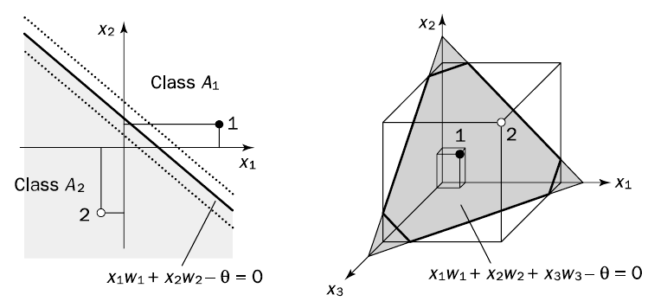
Perceptron - intuition
A perceptron defines a hyperplane in N-1 space: a line in 2-D (two inputs), a plane in 3-D (three inputs),….
The perceptron is a linear classifier: It’s output is 0 on one side of the plane, and 1 for the other.
Given a linearly separable problem, the perceptron learning rule guarantees convergence.
JST 2 - Perceptron

Slide 17
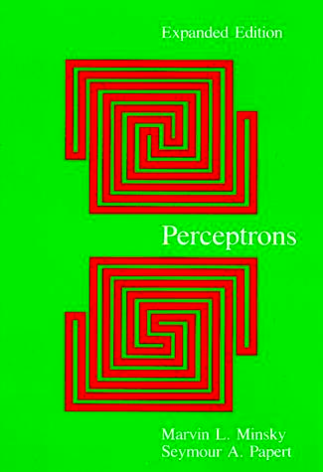

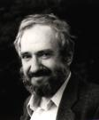
Perceptrons Story
In the popular history of neural networks, first came the classical period of perceptron, when it seemed as if neural networks could do anything.
A hundred algorithms bloomed, a hundred schools of learning machines contended.
Then came the onset of dark ages, where suddenly, research on neural networks was unloved, unwanted, and most important, unfunded.
A precipitating factor in this sharp decline was the publication of the book Perceptrons by Marvin L. Minsky and Seymour A. Papert in 1969.
JST 2 - Perceptron

Slide 18

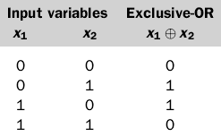

Perceptrons Story
Marvin Minsky and Seymour Papert, in 1969, published Perceptrons, in which they mathematically proved that single-layer perceptrons were only able to distinguish linearly separable classes of patterns.
  While true, they also (mistakenly) speculated that an extension to multiple layers would lose the “virtue” of the perceptron’s simplicity and be otherwise “sterile”.
  As a result of Minsky & Papert’s Perceptrons, research in neural networks was effectively abandoned in the 1970s and early 1980s
The XOR (parity) problem
JST 2 - Perceptron

Slide 19
Limitation of perceptrons
The problem with two-layer perceptrons: They can only map similar inputs to similar outputs.
“Minsky and Papert have provided a very careful analysis of conditions under which such systems are capable of carrying out the required mappings.They show that in a large number of interesting cases, networks of this kind are incapable of solving the problems” (Rumelhart, Hinton and Williams; 1986)
The XOR (parity) problem
JST 2 - Perceptron

Slide 20


Perceptrons
(These) authors expressed the strong belief that limitations of the kind they discovered for simple perceptrons would be held to be true for perceptron variants. more specifically, multilayer systems.
. . . This conjecture . . . thoroughly dampened the enthusiasm of granting agencies to support future research.
Why bother, since more complex versions would have the same problems?
JST 2 - Perceptron

Slide 21
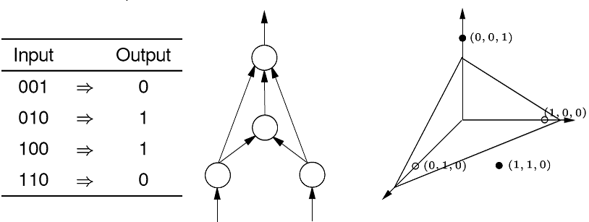
Hidden units can help!
“On the other hand, as Minsky and Papert also pointed out, if there is a layer of simple perceptron-like hidden units . . . there is always a recoding (i.e. an internal representation) of the input patterns in the hidden units in which the similarity of the patterns among the hidden units can support any required mapping from the input to the output units” (Rumelhart, Hinton and Williams; 1986)
JST 2 - Perceptron

Slide 22
Boolean XOR
XOR
input x1 | input x2 | ouput
0 | 0 | 0
0 | 1 | 1
1 | 0 | 1
1 | 1 | 0
o
-0.5
1
-1
OR
AND
-0.5
h₁
h₁
-1.5
1
1
1
1
x₁
x₁
JST 2 - Perceptron

Slide 23
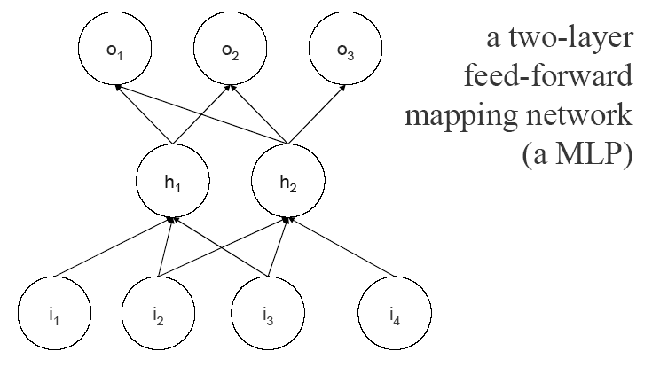
Multilayer Perceptron (Feed-Forward Network)
JST 2 - Perceptron

Slide 24
Weights to hidden units: how to learn?
“The problem, as noted by Minsky and Papert, is that whereas there is a very simple guaranteed learning rule for all problems that can be solved without hidden units, namely the perceptron convergence procedure, there is no equally powerful rule for learning in networks with hidden units” (Rumelhart, Hinton and Williams; 1986)
The learning rule dened for the perceptron and ADAline update the weights to the output units using the error between the actual output and the desired output. The challenge is:
How do you compute the error for the hidden units?
JST 2 - Perceptron

Slide 25
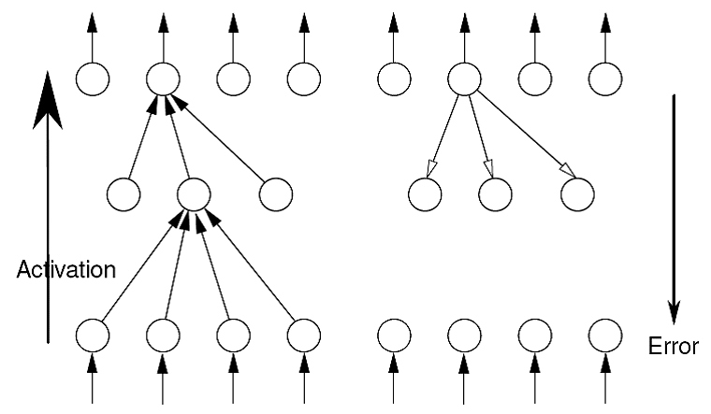
Activation and Error back-propagation
JST 2 - Perceptron

Slide 26
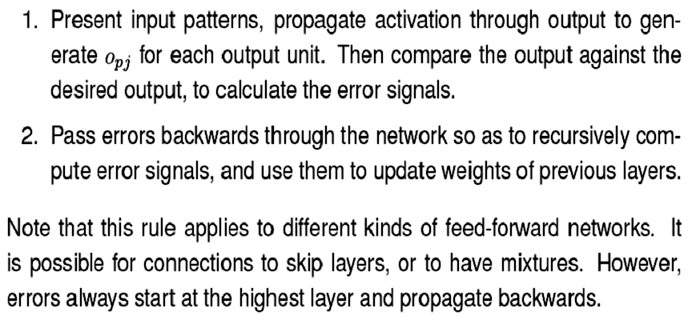
Two phases of Back-Propagation
JST 2 - Perceptron

Slide 27
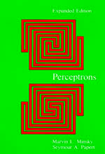
What do Minsky and Papert NOW think?
“In preparing this edition we were tempted to “bring (our) theories up to date”. But when we found that little of significance had chanced since 1969, when the book was first published, we concluded that it would be more useful to keep the original text (with its corrections of 1972) and add an epilogue, so that the book could still be read in its original form” (Minsky and Papert's prologue to the 1988 edition of Perceptrons)
“Original “Back-prop” paper of Rumelhart et. al. When reading it, note the reversed indexing of weights. What we call as w_{ij} is denoted as w_{ji} in their notation” (Epilogue of the book Perceptrons)
Perceptrons - Expanded Edition
An Introduction to Computational Geometry
Marvin L. Minsky and Seymour A. Papert
December 1987
ISBN 0-262-63111-3
6 x 9, 275 pp.
JST 2 - Perceptron

Slide 28
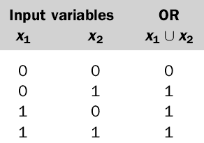
Exercise: Funny Gate
X₁
W₁
Y
0
W₂
X₂
Initial Weight: W₁ = 0.1 ; W₂ = -0.3
Learning Rate α = 0.1
Threshold θ = 0.3
Kerjakan sampai 2 epoch saja.
Nilai max = 16 point
JST 2 - Perceptron

